Slide 1
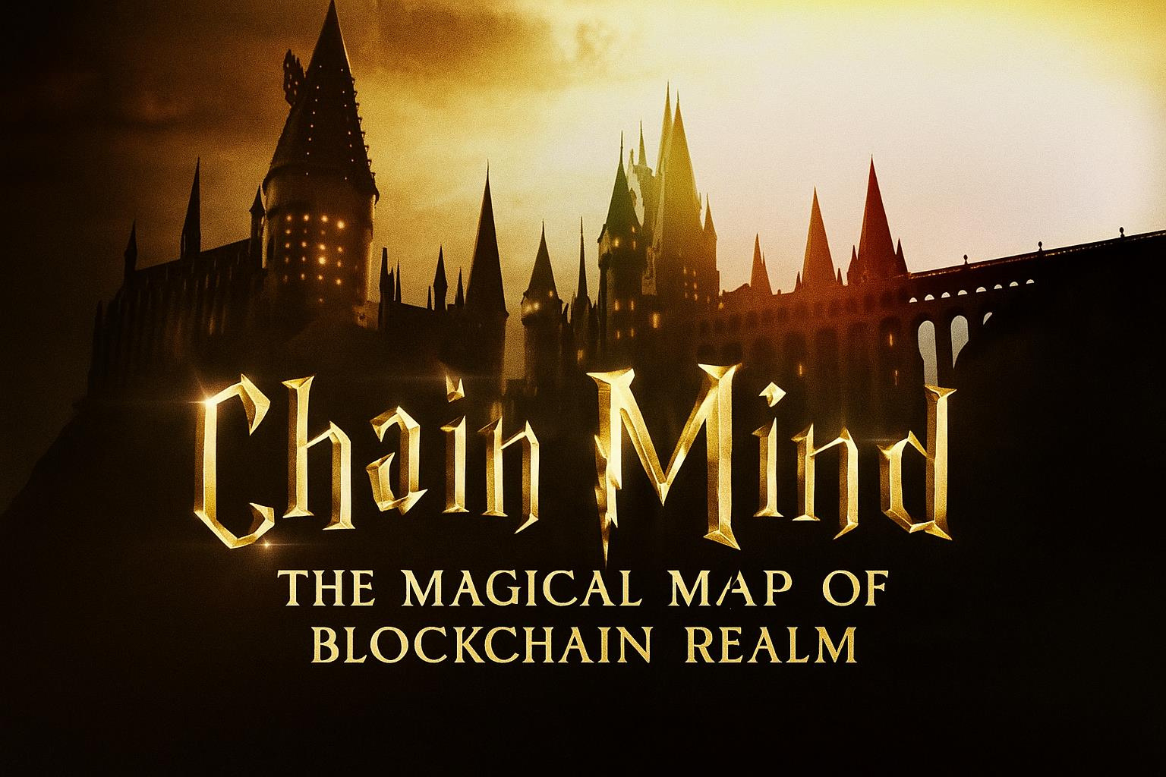








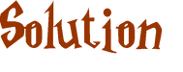

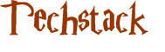
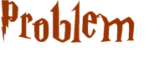

Slide 2
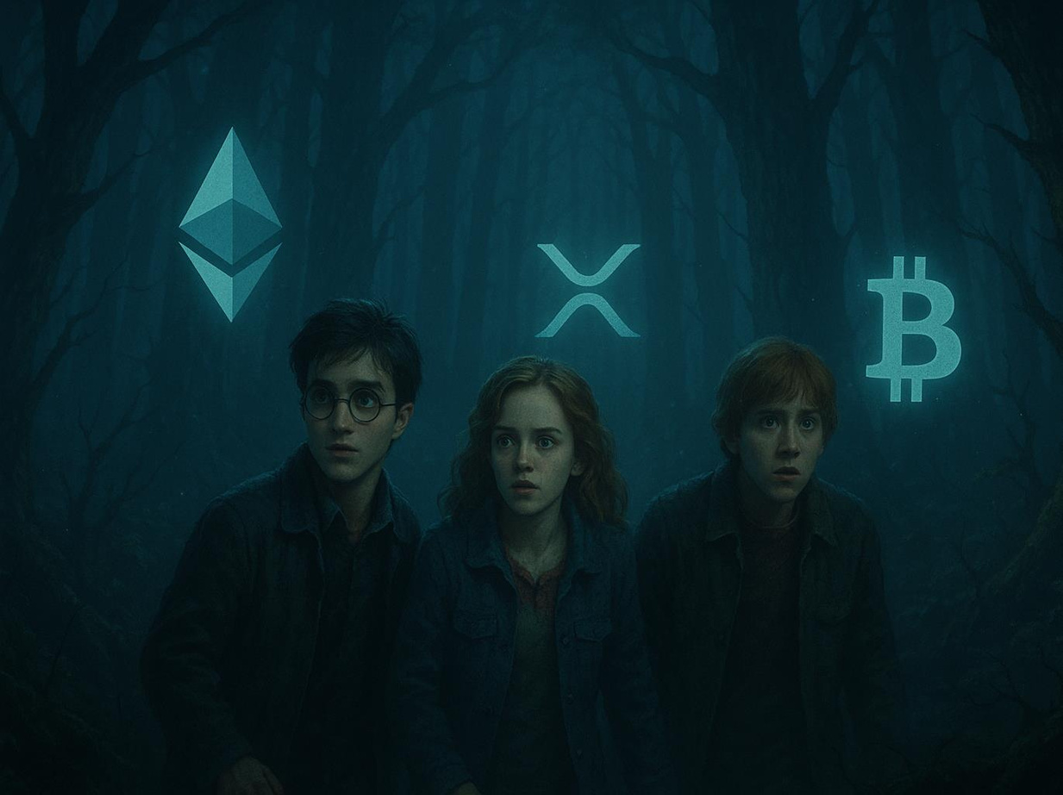

The Dark Forest of Blockchain Data
•Blockchain data is like the Forbidden Forest: vast, mysterious,
and hard to navigate.
•Muggles (non-devs) struggle to track wallets, understand token
movements, or react in time.
•Fragmentation across blockchains adds to the chaos.

Slide 3
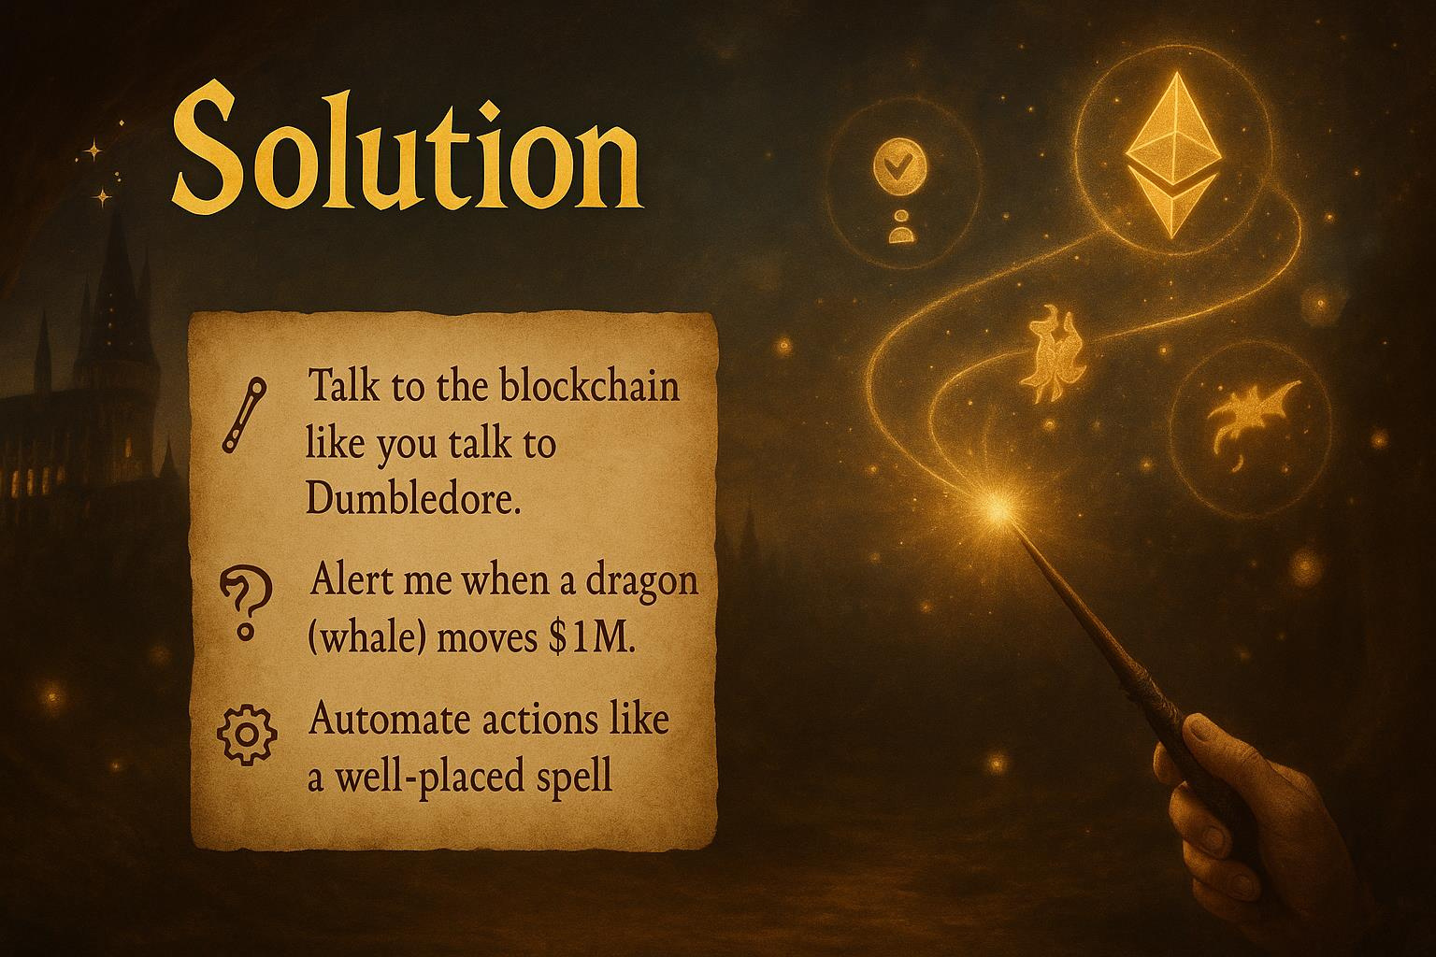
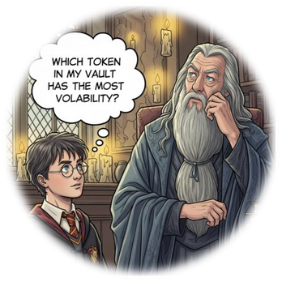

Slide 4
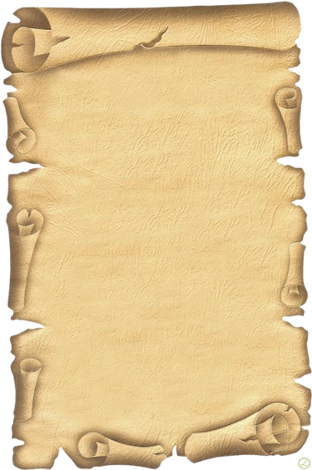
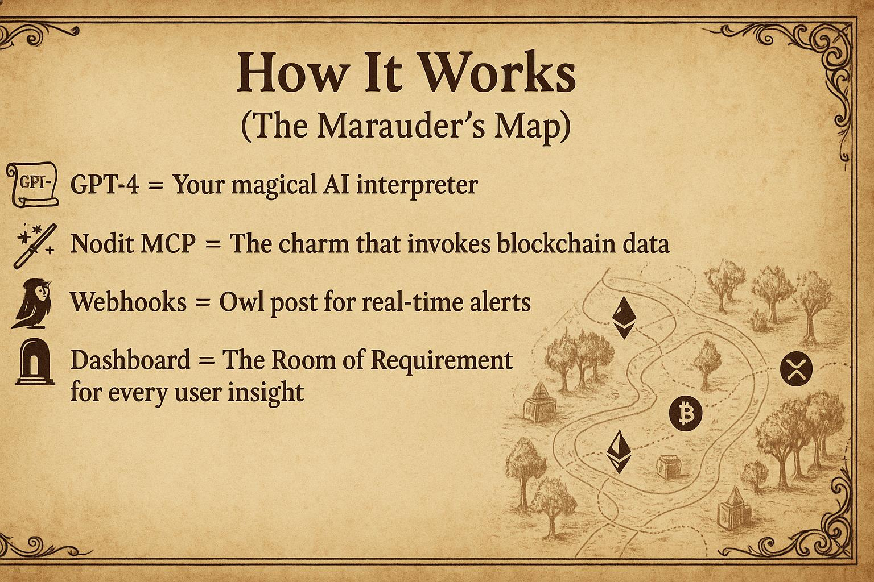

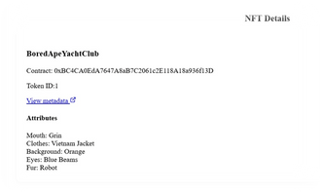
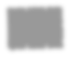
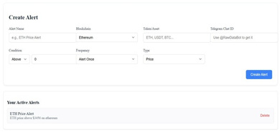
This shows the metadata of anyNFT
This provide real-time alerts when a certain Cryptocurrency hits a user-specified value through a Telegram bot.

Slide 5


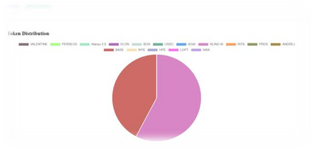
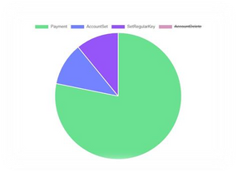
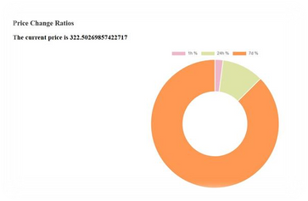
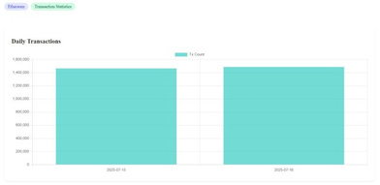
This graph shows the tokens that are deposited and withdrawn from the wallet alongsidetheirvalues
This chart shows the activity done byawallet
This chart shows the 1h% 24h% 7d% change of a particular token alongside its currentmarketprice
This chart shows the transaction stats of Ethereum Chain in thepast2days

Slide 6
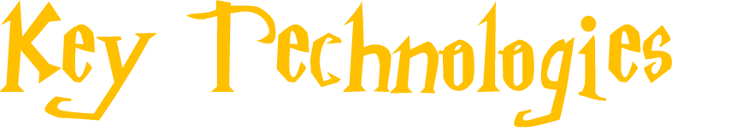


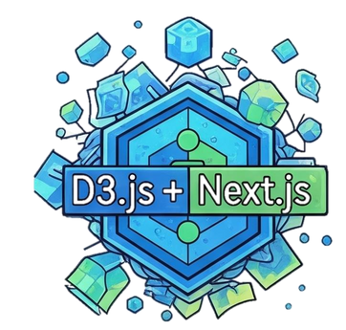

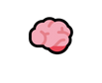


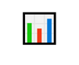
: Magical techstack
LangChain
Nodit MCP =
Webhooks
D3.js + Next.js
+GPT-4= Spellbook for natural queries
Magical conduit to fetch info
= Instant alerts like Fawkes the phoenix
= Interactive scrolls for insights

Slide 7
